Slide 1


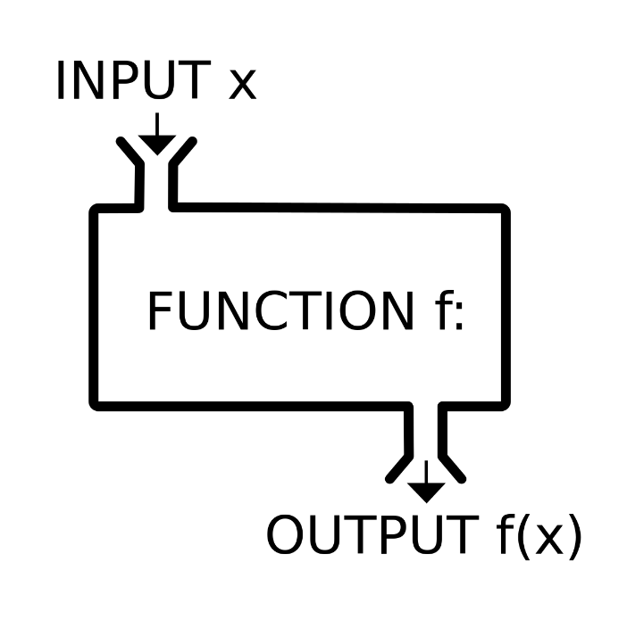


Methods, Debugging and Troubleshooting Code
Defining and Using Methods, Overloads, Debugging
Methods
SoftUni Team
Technical Trainers
Software University
http://softuni.bg

Slide 2
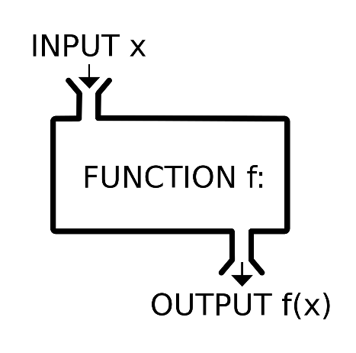

Table of Contents
Using Methods
What is a Method? Why Use Methods?
Declaring and Invoking Methods
Methods with Parameters
Passing Parameters and Returning Values
Method Overloading
Debugging and Program Flow
Methods – Naming and Best Practices

Slide 3
Questions?
sli.do #fund-softuni

Slide 4
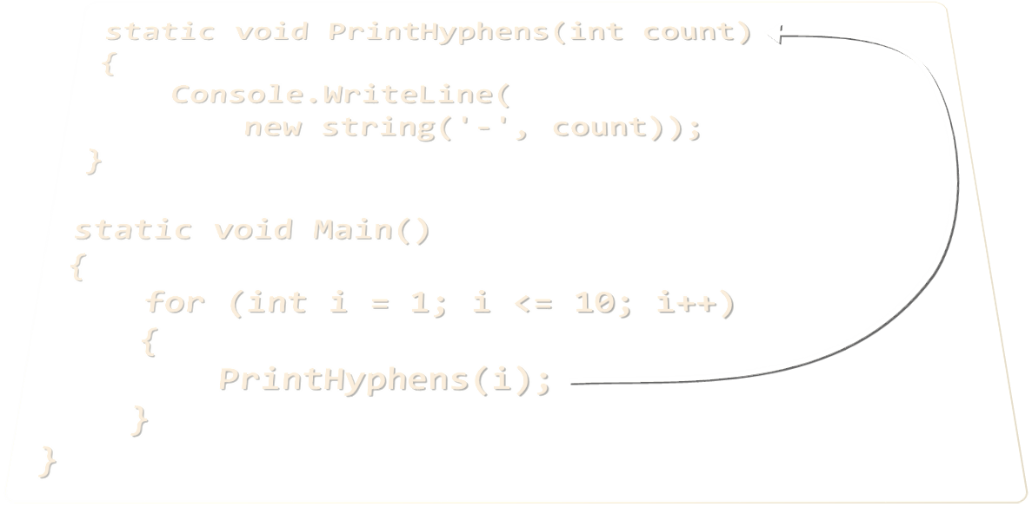
Declaring and Invoking Methods

Slide 5
Simple Methods
Methods are named pieces of code that can be invoked later
Sample method definition:
Invoking (calling) the method several times:
Method named PrintHeader
static void PrintHeader()
{
Console.WriteLine("----------");
}
Method body always surrounded by { }
PrintHeader();
PrintHeader();

Slide 6
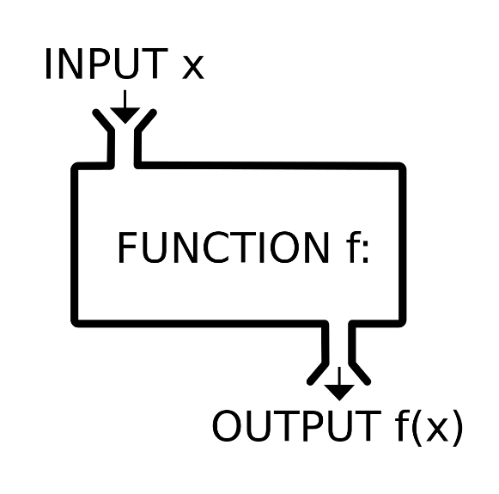

Why Use Methods?
More manageable programming
Splits large problems into small pieces
Better organization of the program
Improves code readability
Improves code understandability
Avoiding repeating code
Improves code maintainability
Code reusability
Using existing methods several times
Methods

Slide 7
Declaring Methods
Return Type
Method Name
Parameters
static double GetSquare(double num)
{
return num * num;
}
Method Body
Methods are declared inside a class
Main() is also a method
Variables inside a method are local
class Program
{
static void Main()
{
}
}

Slide 8
Invoking a Method
Methods are first declared, then invoked (many times)
Methods can be invoked (called) by their name + ():
static void PrintHeader()
{
Console.WriteLine("----------");
}
Method Declaration
static void Main()
{
PrintHeader();
}
Method Invocation

Slide 9
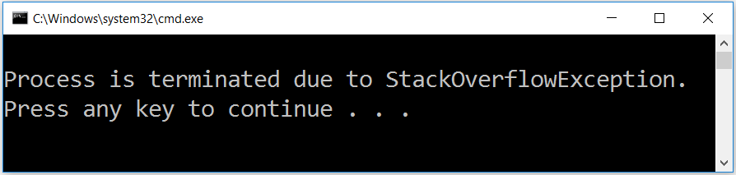
Invoking a Method (2)
A method can be invoked from:
The main method – Main()
Its own body – recursion
Some other method
static void Main()
{
PrintHeader();
}
static void PrintHeader()
{
PrintHeaderTop();
PrintHeaderBottom();
}
static void Crash()
{ Crash(); }

Slide 10
Problem: Blank Receipt
Create a method that prints a blank cash receipt:
CASH RECEIPT
------------------------------
Header
Charged to____________________
Received by___________________
Body
------------------------------
© SoftUni
Footer
Check your solution here: https://judge.softuni.bg/Contests/Practice/Index/304#0

Slide 11
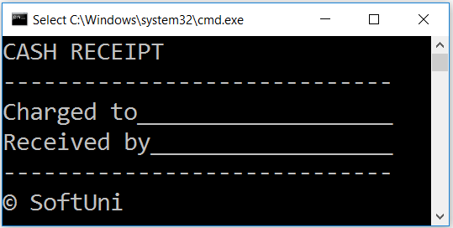
Solution: Blank Receipt
Create 3 methods to print each section (header + body + footer)
Copy the content from the slide
For the copyright sign use the Unicode "\u00A9"
Create a method PrintReceipt() that calls these 3 methods:
private static void PrintReceipt()
{
PrintHeader();
PrintBody();
PrintFooter();
}
Check your solution here: https://judge.softuni.bg/Contests/Practice/Index/304#0

Slide 12

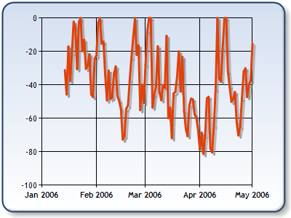
Methods with Parameters
int
long
double
float
decimal

Slide 13
Method Parameters
Accept parameters
start and end of type int
Method parameters can be of any data type
Call the method with certain values (arguments)
static void PrintNumbers(int start, int end)
{
for (int i = start; i <= end; i++)
{
Console.Write("{0} ", i);
}
}
Multiple parameters separated by comma
static void Main()
{
PrintNumbers(5, 10);
}
Passing arguments at invocation

Slide 14
Method Parameters (2)
You can pass zero or several parameters
You can pass parameters of different types
Each parameter has name and type
Multiple parameters of different types
Parameter type
Parameter name
static void PrintStudent(string name, int age, double grade)
{
Console.Write("Student: {0}; Age: {1}, Grade: {2}",
name, age, grade);
}

Slide 15
Problem: Sign of Integer Number
Create a method that prints the sign of an integer number n:
2
The number 2 is positive.
-5
The number -5 is negative.
0
The number 0 is zero.
Check your solution here: https://judge.softuni.bg/Contests/Practice/Index/304#1

Slide 16
Solution: Sign of Integer Number
static void PrintSign(int number)
{
if (number > 0)
Console.WriteLine("The number {0} is positive", number);
else if (number < 0)
Console.WriteLine("The number {0} is negative.", number);
else
Console.WriteLine("The number {0} is zero.", number);
}
static void Main()
{ PrintSign(int.Parse(Console.ReadLine())); }
Check your solution here: https://judge.softuni.bg/Contests/Practice/Index/304#1

Slide 17
Optional Parameters
Parameters can accept default values:
The above method can be called in several ways:
static void PrintNumbers(int start = 0, int end = 100)
{
for (int i = start; i <= end; i++)
{
Console.Write("{0} ", i);
}
}
Default values
Can be skipped at method invocation
PrintNumbers(5, 10);
PrintNumbers(15);
PrintNumbers();
PrintNumbers(end: 40, start: 35);

Slide 18
Problem: Printing Triangle
Create a method for printing triangles as shown below:
1
1 2
1 2 3
1 2 3 4
1 2 3
1 2
1
1
1 2
1 2 3
1 2
1
3
4
Check your solution here: https://judge.softuni.bg/Contests/Practice/Index/304#2

Slide 19
Solution: Printing Triangle
Create a method that prints a single line, consisting of numbers from a given start to a given end:
static void PrintLine(int start, int end)
{
for (int i = start; i <= end; i++)
{
Console.Write(i + " ");
}
Console.WriteLine();
}
Check your solution here: https://judge.softuni.bg/Contests/Practice/Index/304#2

Slide 20
Solution: Printing Triangle (2)
Create a method that prints the first half (1..n) and then the second half (n-1…1) of the triangle:
Method with parameter n
static void PrintTriangle(int n)
{
for (int line = 1; line <= n; line++)
PrintLine(1, line);
for (int line = n - 1; line >= 1; line--)
PrintLine(1, line);
}
Lines 1...n
Lines n-1…1
Check your solution here: https://judge.softuni.bg/Contests/Practice/Index/304#2

Slide 21
Problem: Draw а Filled Square
Draw at the console a filled square of size n like in the example:
static void PrintHeaderRow(int n)
{
Console.WriteLine(new
string('-', 2 * n));
}
static void PrintMiddleRow(int n)
{
Console.Write('-');
for (int i = 1; i < n; i++)
Console.Write("\\/");
Console.WriteLine('-');
}
--------
-\/\/\/-
-\/\/\/-
--------
4
Method with parameter n
static void Main() {
int n = // TODO: read n
PrintHeaderRow(n);
for (int i = 0; i < n - 2; i++)
PrintMiddleRow(i);
PrintHeaderRow(n);
}
Check your solution here: https://judge.softuni.bg/Contests/Practice/Index/304#3

Slide 22

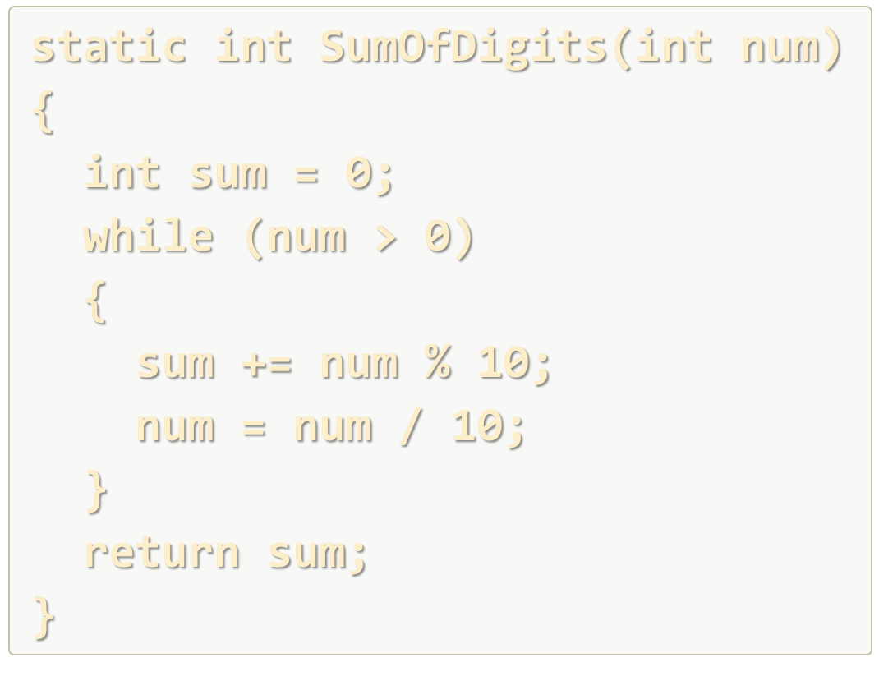
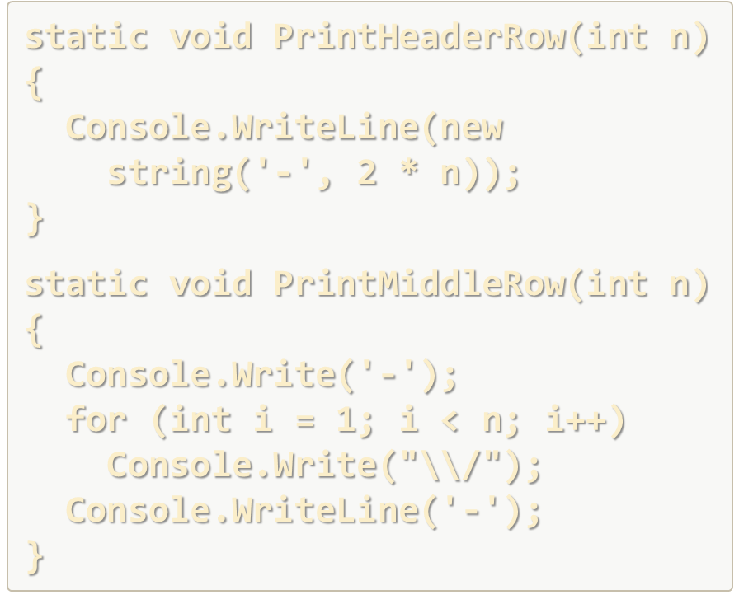
Declaring and Invoking Methods
Live Exercises in Class (Lab)

Slide 23
Returning Values From Methods

Slide 24
Method Return Types
Type void – does not return a value (only executes code)
Other types – return values, based on the method's return type
static void AddOne(int n)
{
n += 1;
Console.WriteLine(n);
}
No return statement
static int PlusOne(int n)
{
return n + 1;
}
return an int value

Slide 25
The Return Statement
The return keyword immediately stops the method's execution
Returns the specified value
Void methods can be terminated by just using return
static string ReadFullName()
{
string firstName = Console.ReadLine();
string lastName = Console.ReadLine();
return firstName + " " + lastName;
}
Return a string
return;

Slide 26
Using the Return Values
Return value can be:
Assigned to a variable:
Used in expression:
Passed to another method:
int max = GetMax(5, 10);
decimal total = GetPrice() * quantity * 1.20m;
int age = int.Parse(Console.ReadLine());

Slide 27
Temperature Conversion – Example
Convert temperature from Fahrenheit to Celsius:
static double FahrenheitToCelsius(double degrees)
{
double celsius = (degrees - 32) * 5 / 9;
return celsius;
}
static void Main()
{
Console.Write("Temperature in Fahrenheit: ");
double t = Double.Parse(Console.ReadLine());
t = FahrenheitToCelsius(t);
Console.Write("Temperature in Celsius: {0}", t);
}
TODO: add to judge!

Slide 28
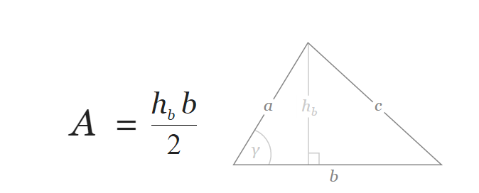
Problem: Calculate Triangle Area
Create a method that calculates and returns the area of a triangle by given width and height
b = 3
h_{b} = 4
A = 6
Check your solution here: https://judge.softuni.bg/Contests/Practice/Index/304#4

Slide 29
Solution: Calculate Triangle Area
Create a method with two double parameters and a double return value:
static double CalcTriangleArea(double width, double height)
{
return width * height / 2;
}
static void Main()
{
double width = double.Parse(Console.ReadLine());
double height = double.Parse(Console.ReadLine());
Console.WriteLine(CalcTriangleArea(width, height));
}
Check your solution here: https://judge.softuni.bg/Contests/Practice/Index/304#4

Slide 30
Problem: Power Method
Create a method that calculates and returns the value of a number raised to a given power
2⁸
256
3⁴
81
static double RaiseToPower(double number, int power)
{
double result = 1;
for (int i = 0; i < power; i++)
result *= number;
return result;
}
Check your solution here: https://judge.softuni.bg/Contests/Practice/Index/304#5

Slide 31

Overloading Methods

Slide 32
Method Signature
The combination of method's name and parameters is called signature
Signature differentiates between methods with same names
When methods with the same name have different signatures, this is called method "overloading"
Method's signature
static void Print(string text)
{
Console.WriteLine(text);
}

Slide 33
Overloading Methods
Using same name for multiple methods with different signatures (method name and parameters)
static void Print(string text)
{
Console.WriteLine(text);
}
Different method signatures
static void Print(int number)
{
Console.WriteLine(number);
}
static void Print(string text, int number)
{
Console.WriteLine(text + ' ' + number);
}

Slide 34
Signature and Return Type
Method's return type is not part of its signature
Consider the example:
How would the compiler know which method to call?
static void Print(string text)
{
Console.WriteLine(text);
}
Compile-time error!
static string Print(string text)
{
return text;
}

Slide 35
Problem: Greater of Two Values
Create a method GetMax() that returns the greater of two values (the values can be of type int, char or string)
int
2
16
16
char
a
z
z
string
aaa
bbb
aaa
Check your solution here: https://judge.softuni.bg/Contests/Practice/Index/304#6

Slide 36
Returning Values and Overloading
Live Exercises in Class (Lab)

Slide 37
Program Execution Flow

Slide 38
Program Execution
The program continues, after a method execution completes:
static void Main()
{
Console.WriteLine("before method executes");
PrintLogo();
Console.WriteLine("after method executes");
}
Executes first
Method call
Executes last
static void PrintLogo()
{
Console.WriteLine("Company Logo");
Console.WriteLine("http://www.companywebsite.com");
}

Slide 39


Program Execution – Call Stack
"The stack" stores information about the active subroutines (methods) of a computer program
Keeps track of the point to which each active subroutine should return control when it finishes executing
Call Stack
call
call
Main
Method A
Main
Method A
Method B
START
Method B
return
return

Slide 40
Problem: Multiply Even by Odd Digits
Create a program that multiplies the sum of all even digits of a number by the sum of all odd digits of the same number:
Create a method called GetMultipleOfEvensAndOdds()
Create a method GetSumOfEvenDigits()
Create GetSumOfOddDigits()
You may need to use Math.Abs() for negative numbers
-12345
Evens: 2 4
Odds: 1 3 5
Even sum: 6
Odd sum: 9
54
Check your solution here: https://judge.softuni.bg/Contests/Practice/Index/304#7

Slide 41

Debugging the Code
Using the Visual Studio Debugger

Slide 42

Debugging the Code
The process of debugging application includes:
Spotting an error
Finding the lines of code that cause the error
Fixing the error in the code
Testing to check if the error is gone and no new errors are introduced
Iterative and continuous process
Debuggers helps a lot. Really!

Slide 43
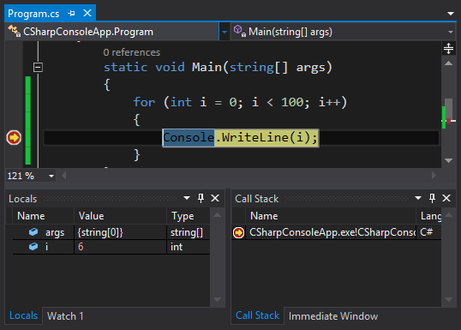
Debugging in Visual Studio
Visual Studio has a built-in debugger
It provides:
Breakpoints
Ability to trace the code execution
Ability to inspect variables at runtime

Slide 44
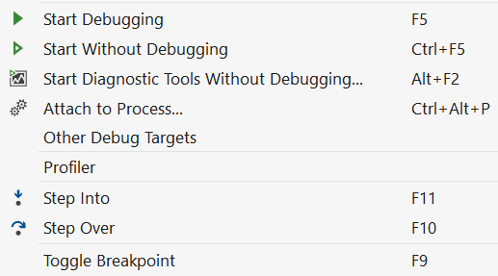
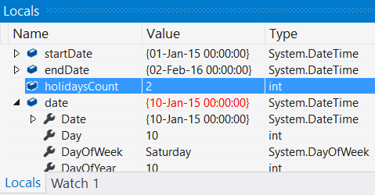
Using the Debugger in Visual Studio
Start without Debugger: [Ctrl+F5]
Toggle a breakpoint: [F9]
Start with the Debugger: [F5]
Trace the program: [F10] / [F11]
Using the Locals / Watches
Conditional breakpoints
Enter debug mode after exception

Slide 45
Problem: Find and Fix the Bugs in the Code
A program aims to count the non-working days between two dates (e.g. 1.05.2016 … 15.05.2016 → 5 non-working days). Debug it!
var startDate = DateTime.ParseExact(Console.ReadLine(),
"dd.m.yyyy", CultureInfo.InvariantCulture);
var endDate = DateTime.ParseExact(Console.ReadLine(),
"dd.m.yyyy", CultureInfo.InvariantCulture);
var holidaysCount = 0;
for (var date = startDate; date <= endDate; date.AddDays(1))
if (date.DayOfWeek == DayOfWeek.Saturday &&
date.DayOfWeek == DayOfWeek.Sunday) holidaysCount++;
Console.WriteLine(holidaysCount);
Check your solution here: https://judge.softuni.bg/Contests/Practice/Index/304#8

Slide 46
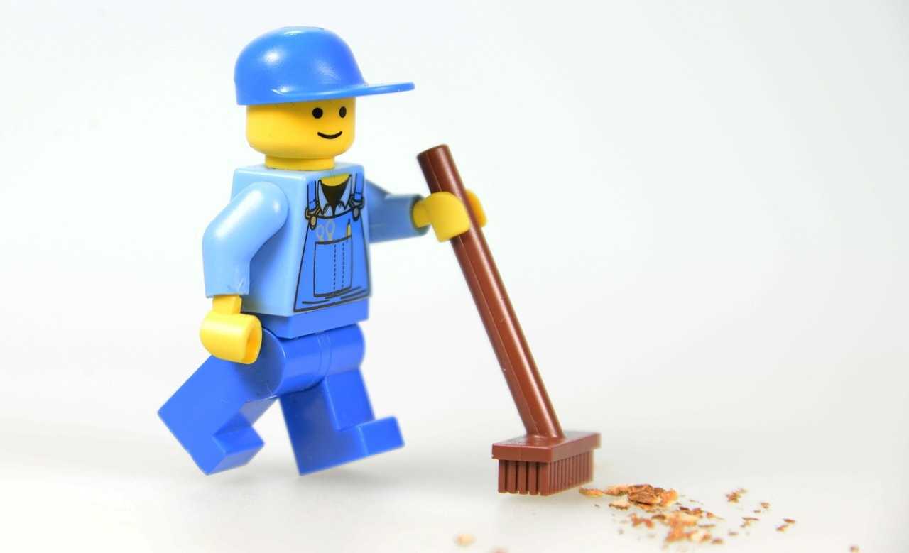
Methods – Naming and Best Practices

Slide 47
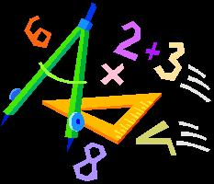


Naming Methods
Methods naming guidelines
Use meaningful method names
Method names should answer the question:
What does this method do?
If you cannot find a good name for a method, think about whether it has a clear intent
FindStudent, LoadReport, Sine
Method1, DoSomething, HandleStuff, SampleMethod, DirtyHack

Slide 48
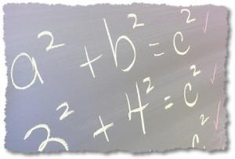
Naming Method Parameters
Method parameters names
Preferred form: [Noun] or [Adjective] + [Noun]
Should be in camelCase
Should be meaningful
Unit of measure should be obvious
firstName, report, speedKmH, usersList, fontSizeInPixels, font
p, p1, p2, populate, LastName, last_name, convertImage

Slide 49
Methods – Best Practices
Each method should perform a single, well-defined task
Method's name should describe that task in a clear and non-ambiguous way
Avoid methods longer than one screen
Split them to several shorter methods
private static void PrintReceipt()
{
PrintHeader();
PrintBody();
PrintFooter();
}
Self documenting and easy to test
Self documenting. Easy to test

Slide 50
Code Structure and Code Formatting
Make sure to use correct indentation
Leave a blank line between methods, after loops and after if statements
Always use curly brackets for loops and if statements
Avoid long lines and complex expressions
static void Main()
{
// some code..
// some more code..
}
static void Main()
{
// some code..
// some more code..
}

Slide 51
Problem: Price Change Alert
A program tracks stock prices and gives updates about the significance in each price change.
Download the source code and get familiar with it: Broken Code
Give methods a proper name
Fix method parameters naming
Deal with poor code formatting
Get(c, l)
GetPercentageDifference(currentPrice, lastPrice)
Check your solution here: https://judge.softuni.bg/Contests/Practice/Index/304#9

Slide 52
Debugging and Program Flow
Live Exercises in Class (Lab)

Slide 53
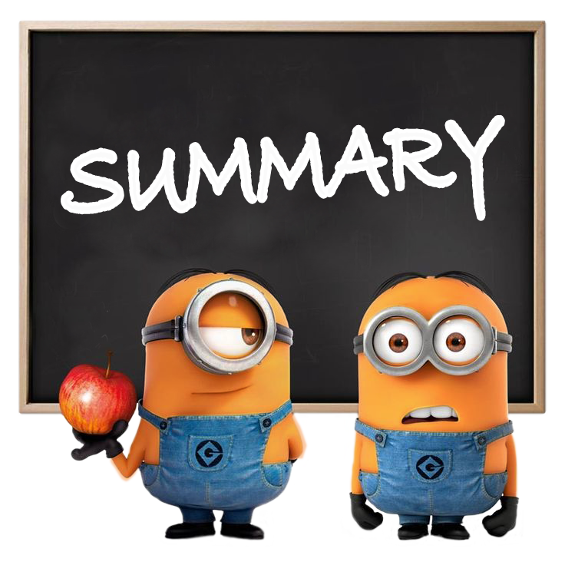
Summary
Break large programs into simple
methods that solve small sub-problems
Methods consist of declaration and body
Methods are invoked by their name
Methods can accept parameters
Parameters take actual values when calling a method
Methods can return a value or nothing (void)
Debugging helps spotting an error more easily

Slide 54

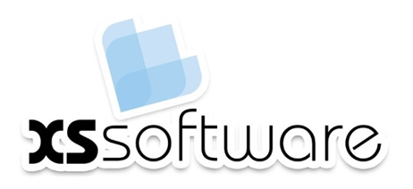








Methods, Debugging and Troubleshooting
https://softuni.bg/courses/programming-fundamentals

Slide 55

License
This course (slides, examples, demos, videos, homework, etc.) is licensed under the "Creative Commons Attribution-NonCommercial-ShareAlike 4.0 International" license
Attribution: this work may contain portions from
"Fundamentals of Computer Programming with C#" book by Svetlin Nakov & Co. under CC-BY-SA license
Icons from http://www.flaticon.com/ (credits: Freepik, Madebyoliver)

Slide 56






Free Trainings @ Software University
Software University Foundation – softuni.org
Software University – High-Quality Education, Profession and Job for Software Developers
softuni.bg
Software University @ Facebook
facebook.com/SoftwareUniversity
Software University @ YouTube
youtube.com/SoftwareUniversity
Software University Forums – forum.softuni.bg

